Slide 1
From Hunger
to Hope

Slide 2
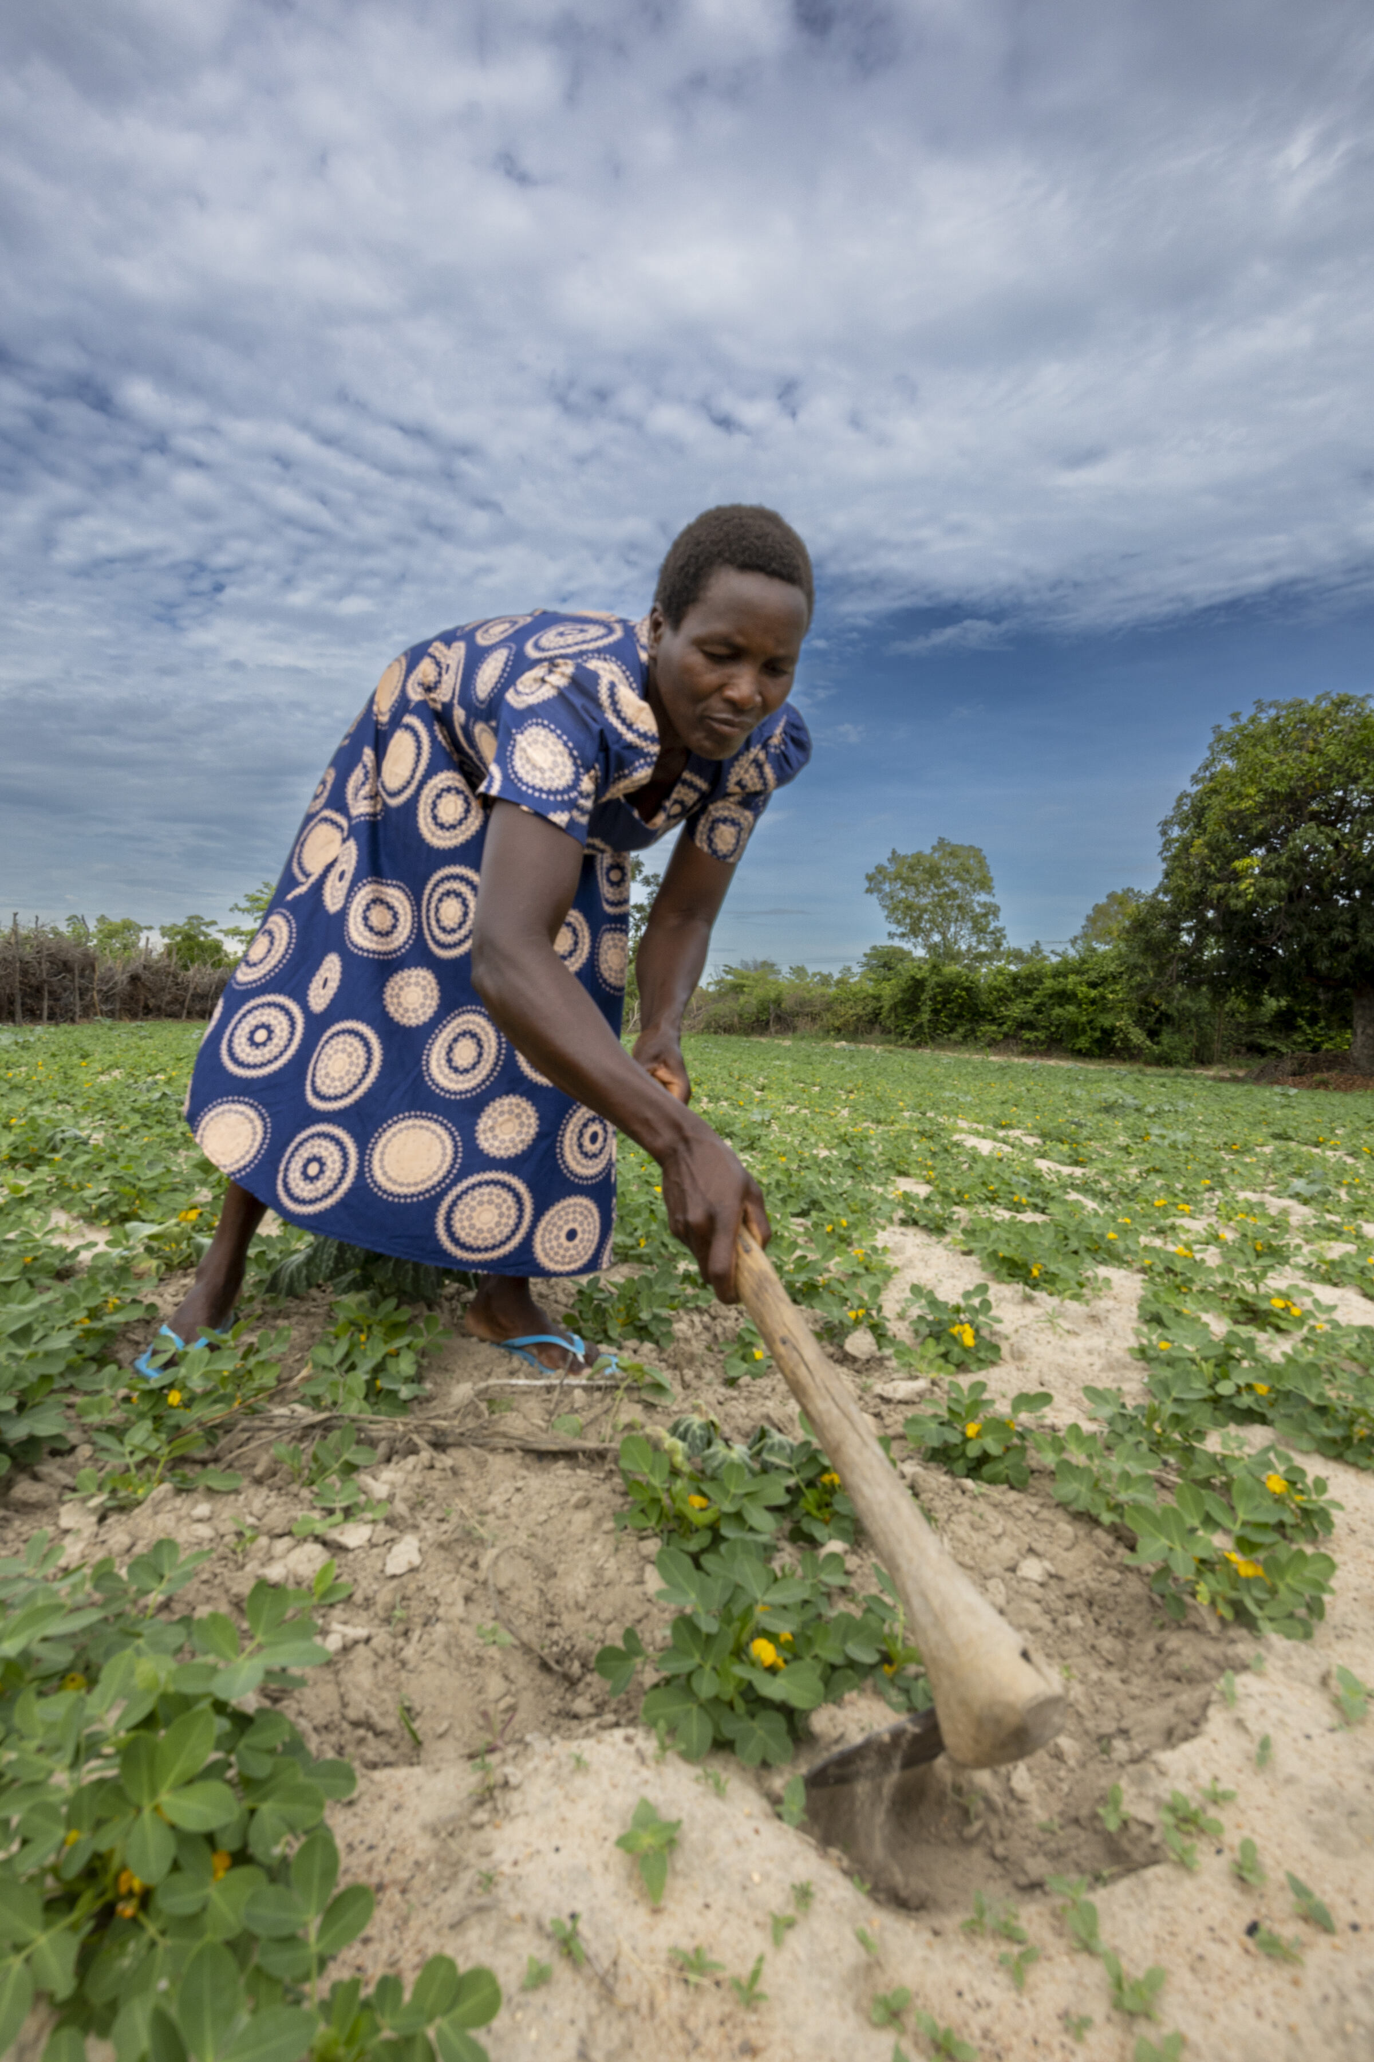
Nyarai Zirugo lives with her family in the Mutoka district of Northeast Zimbabwe.
The climate crisis is threatening her harvest.
Powerful storms are washing away crops and frequent droughts are withering plants.
Nyarai working on her farm

Slide 3
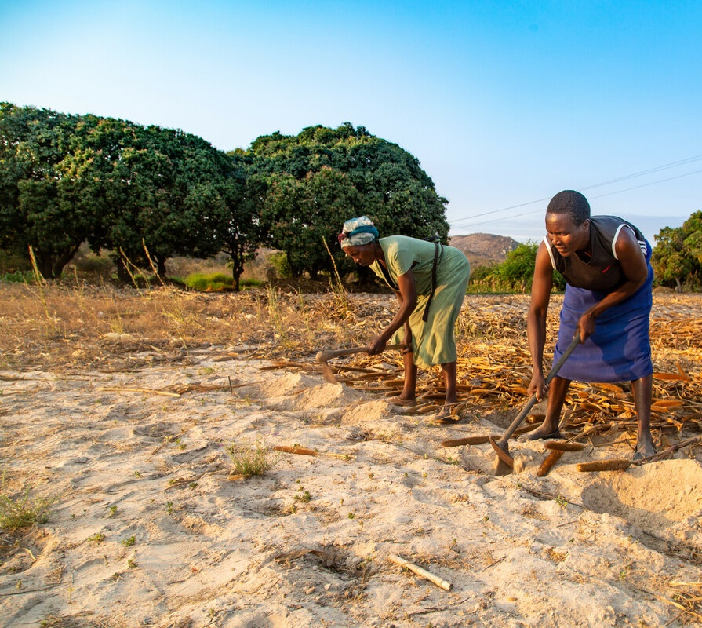
Nyarai made her living by farming
and selling chickens.
Low rainfall meant the harvest was
barely enough to feed her family.
Nyarai and her mother Janet working their farm

Slide 4
Nyarai was determined to provide for her family.
She took agriculture training with help from Christian Aid.
Nyarai on her maize farm

Slide 5
‘One of the main things we got was improved knowledge’, said Nyarai. ‘We learnt how to put in place measures to prepare for unpredictable situations.’

Slide 6
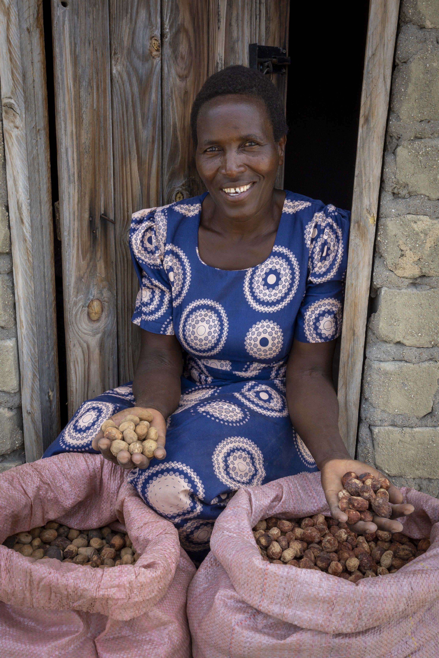
Nyarai learnt how to sustainably harvest many of the wild plants that grow in the hills and forests near her home.
She uses some to improve her family’s diet and prepares others for market using a dryer constructed with help from Christian Aid.
Nyarai shows off her marula nut harvest

Slide 7
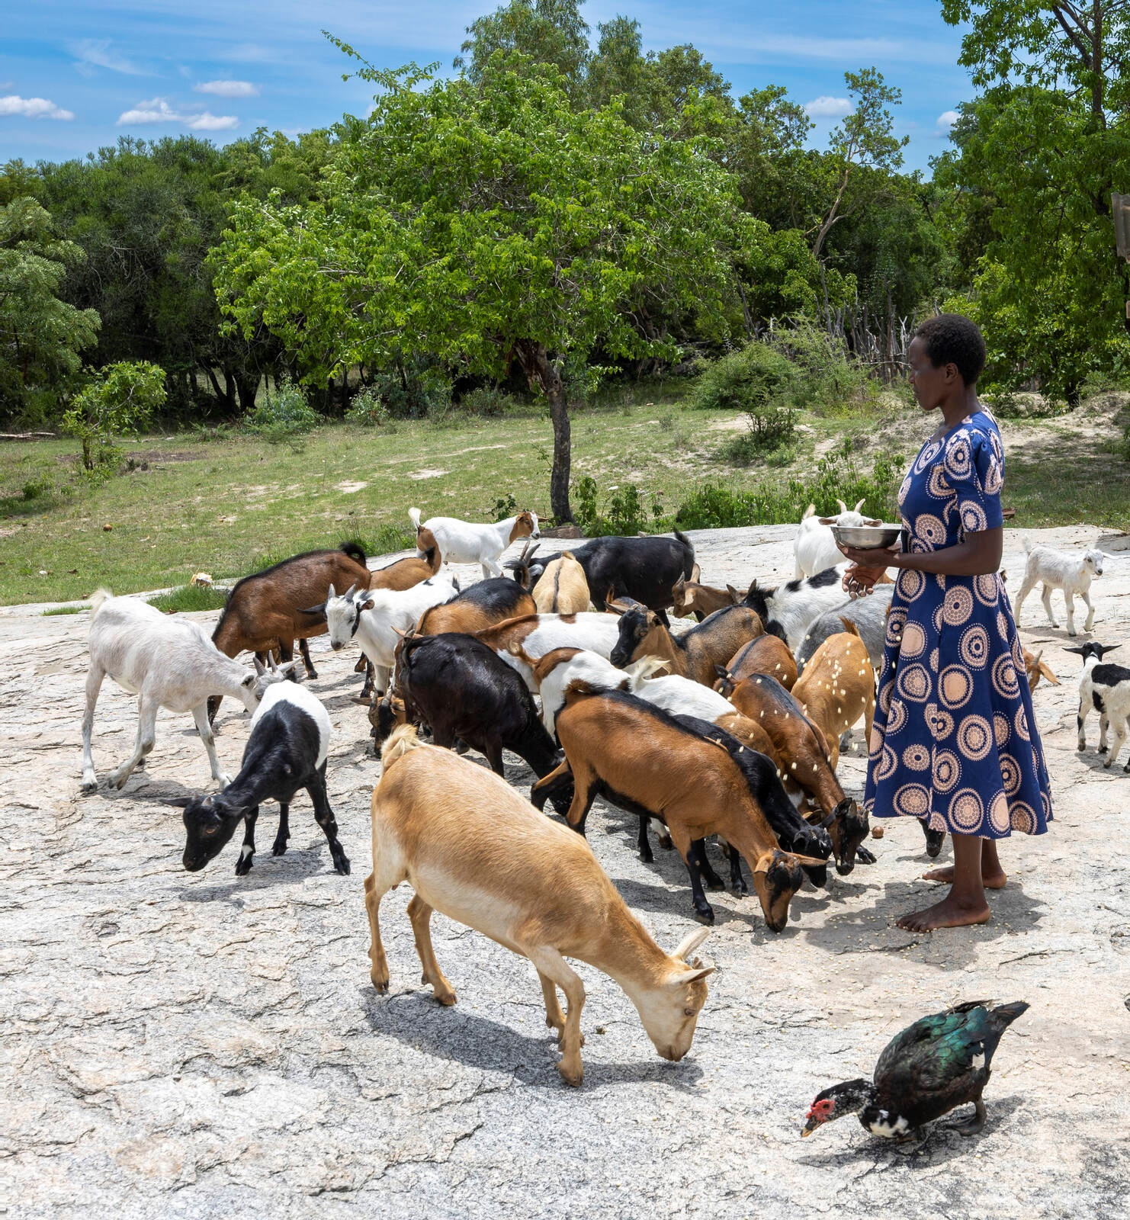
With the profits, the family have bought goats for their farm, as well as groceries, crockery and blankets.
Nyarai also learnt about climate smart agriculture, helping her family to grow a wider range of grains and legumes.
Nyarai feeding her goats

Slide 8
Nyarai summed up the impact of the project saying: ‘We’ve seen our livelihoods, diet and farming methods improve greatly. We are better able to sustain ourselves even when droughts hit.’

Slide 9
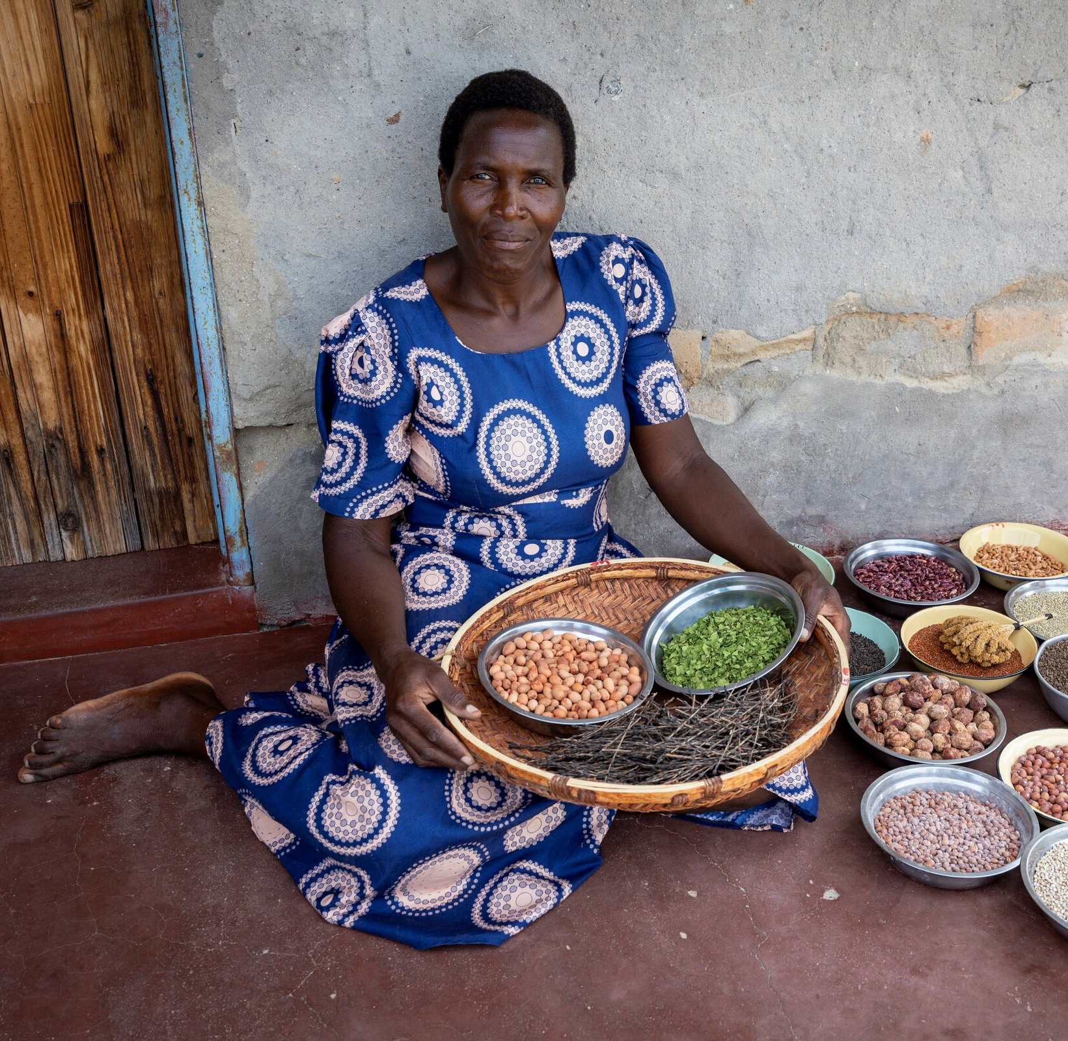
Your donations will help protect the harvest and the hope of farmers like Nyarai and their families.
Photo caption here
Nyarai with a selection of her harvest

